Slide 1
Impact of Science Conference the Parallel Session on:
Mass Media & Communication
25th June, 2021

Slide 2
Impact of Science
23-25 June, 2021
Paul Manners (Chair) : Founding Director, National Co-ordinating Centre for public engagement, UK
Ger Hanley: Founder Write Fund, Republic of Ireland
Dariusz Aksamit: Head of Council of March for Science Foundation, Poland
Marina Joubert: Senior Researcher, Stellenbosch University, South Africa
Overview of the Speakers
#IOS21

Slide 3
Impact of Science
23-25 June, 2021
Ger Hanley
Founder Write Fund, Republic of Ireland
#IOS21

Slide 4
Is Science Communication Accessible?
And what does that mean in reality?
Ger Hanley

Slide 5
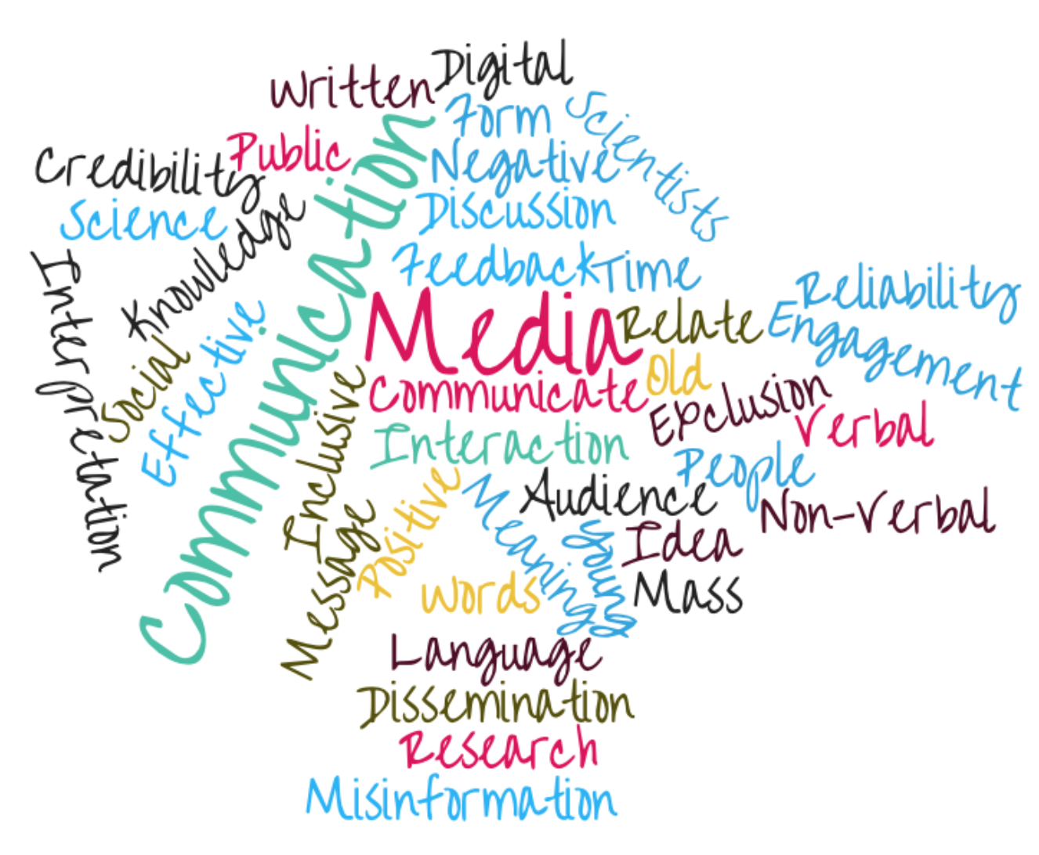
Science Communication

Slide 6
During COVID-19, science communication was never been more vital, drawing a new audience

Slide 7
Science held the missing piece of the puzzle.

Slide 8
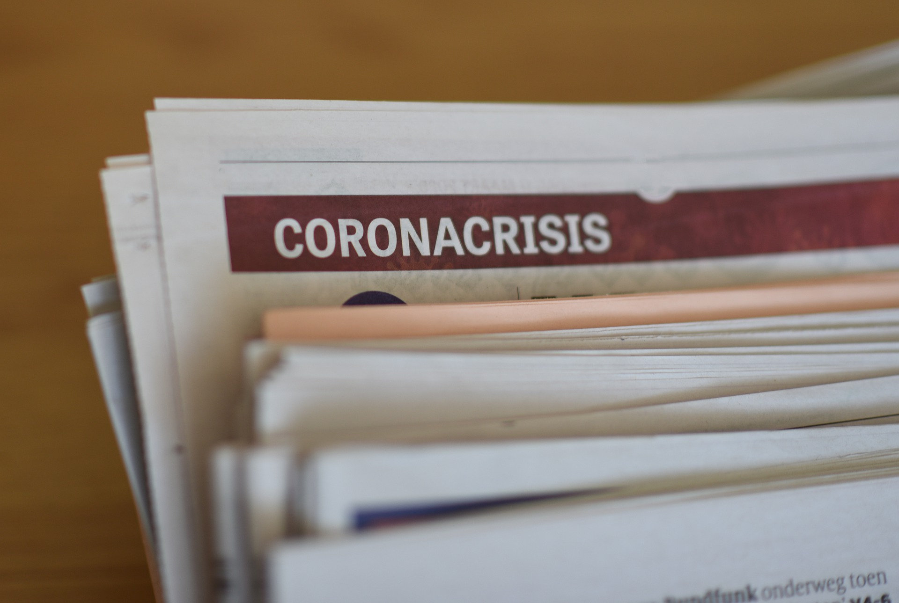
During COVID-19, national scientists and experts became the ‘new’ science and health journalists

Slide 9
Good Pandemic Science Communication
Clear
Transparent
Open
Rapid Reliable Information
Reached every corner of society via
Print
Radio
TV
Online

Slide 10
But was it accessible to all?

Slide 11
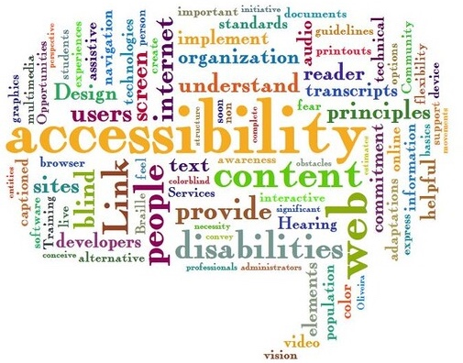
Accessibility

Slide 12
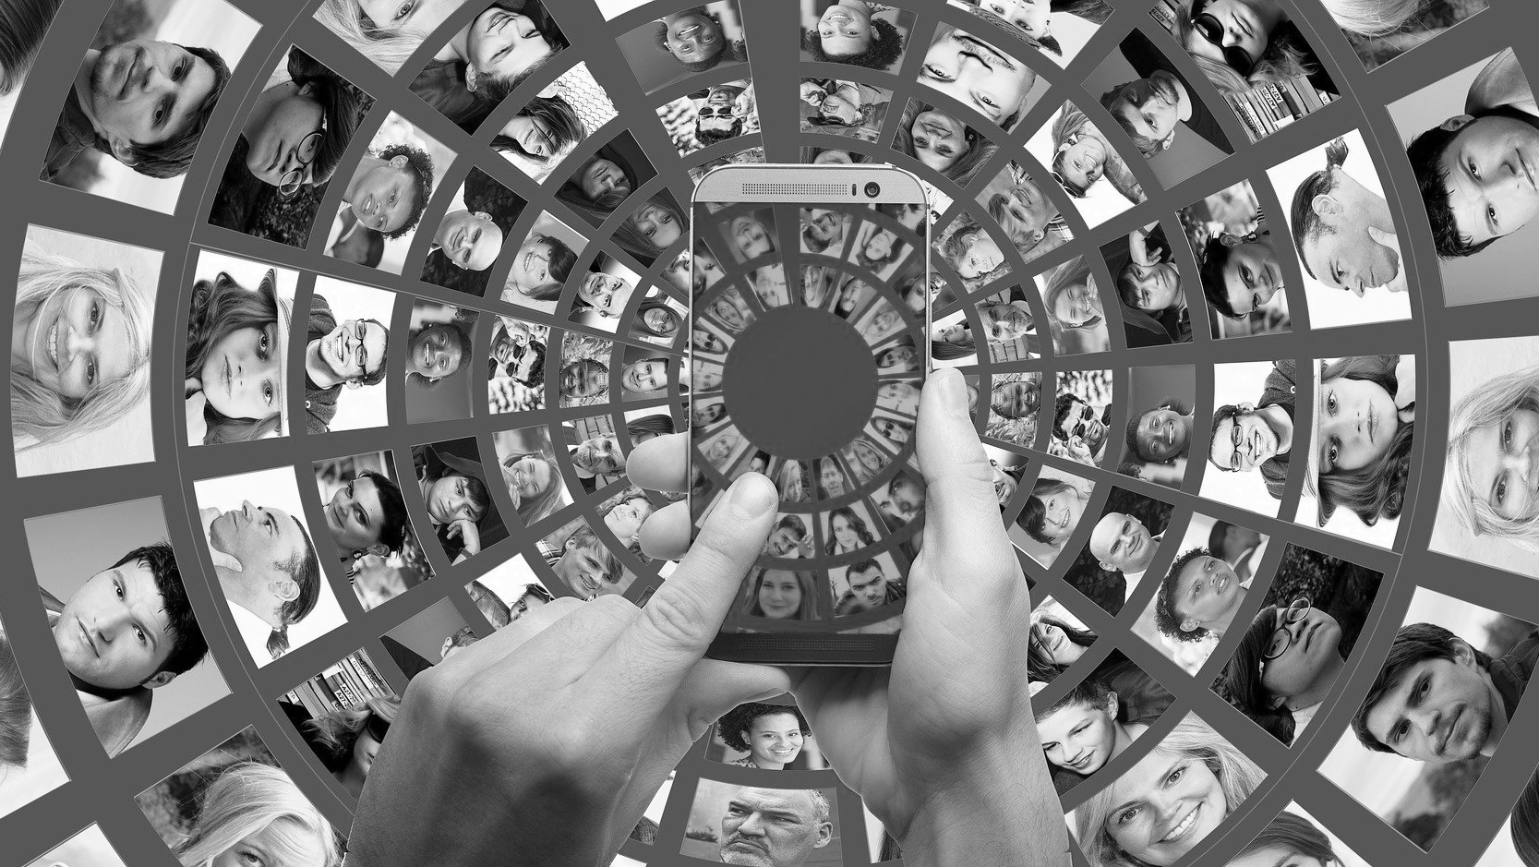
What accessibility actually means
Reach as many people as possible!
It is not a ‘one-size-fits-all’
It addresses barriers and provides a variety of ways for people to engage.

Slide 13
Leave No One Behind
Source: https://commons.wikimedia.org/wiki/File:Sustainable_Development_Goals.jpg
Notes:
Leave no one behind is the central, transformative promise of the 2030 Agenda for Sustainable Development and its Sustainable Development Goals (SDGs).
Source: https://unsdg.un.org/2030-agenda/universal-values/leave-no-one-behind

Slide 14
Inclusive Communication Needs Inclusive Design

Slide 15
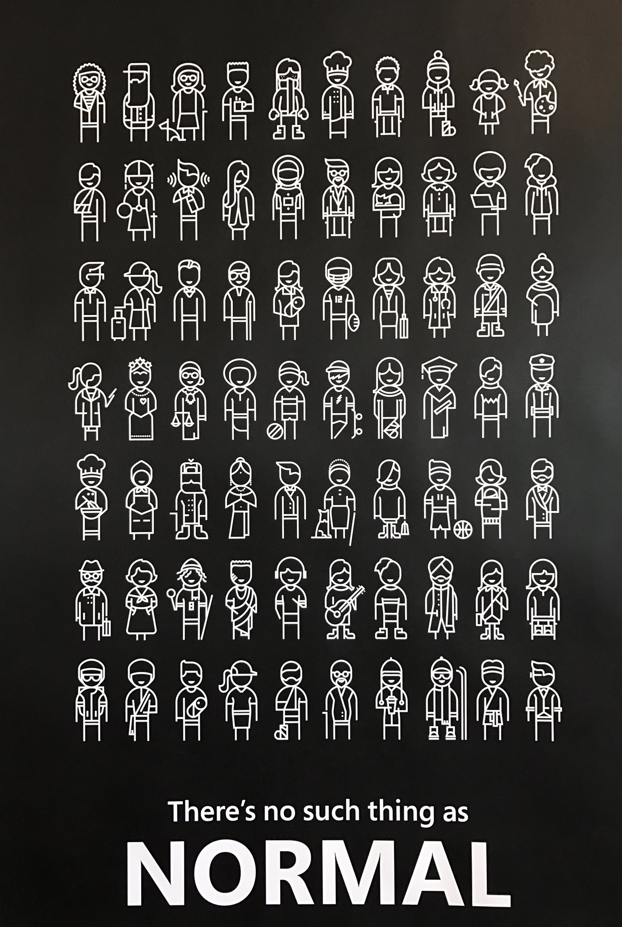
There’s no such thing as normal

Slide 16
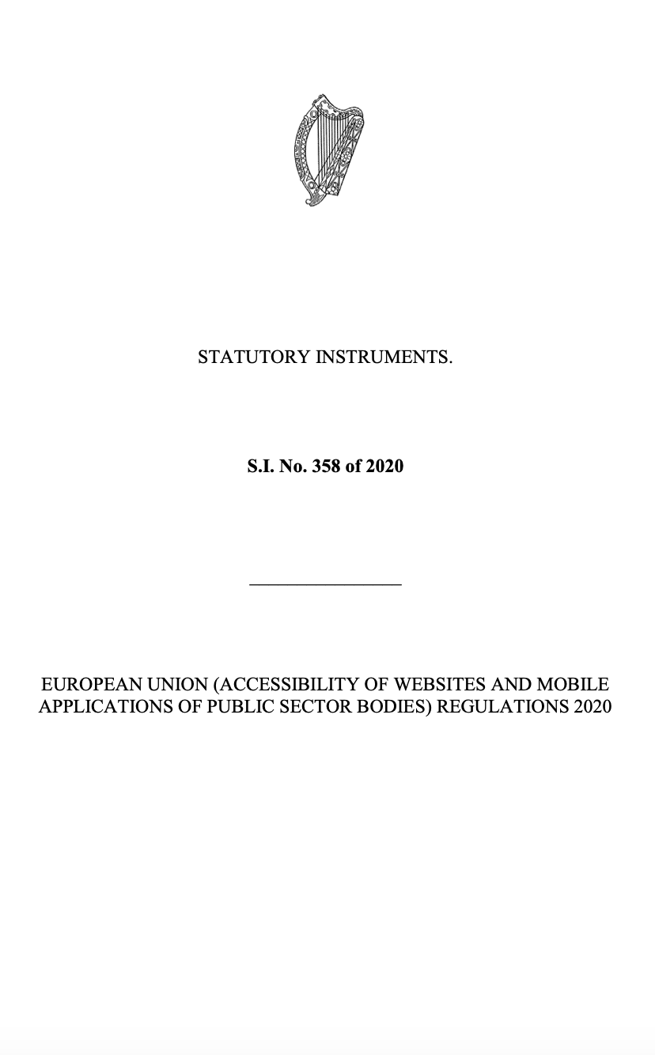
Legislation and Regulations

Slide 17
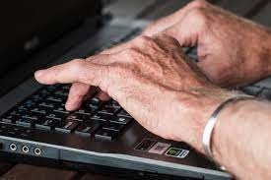
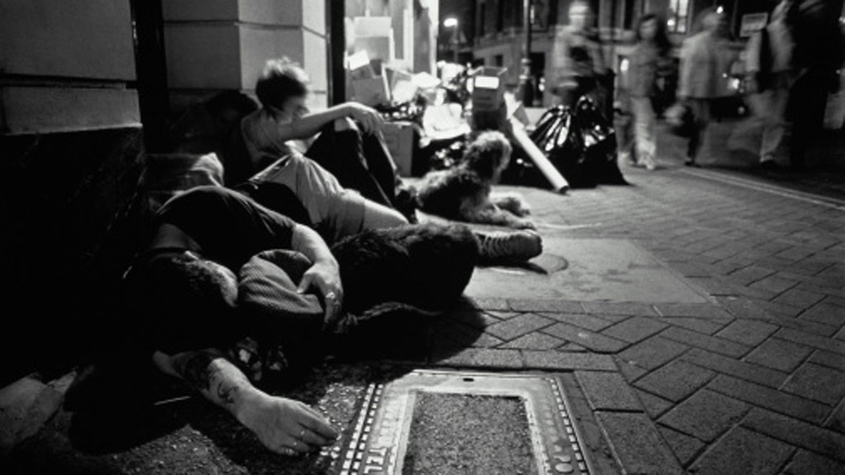
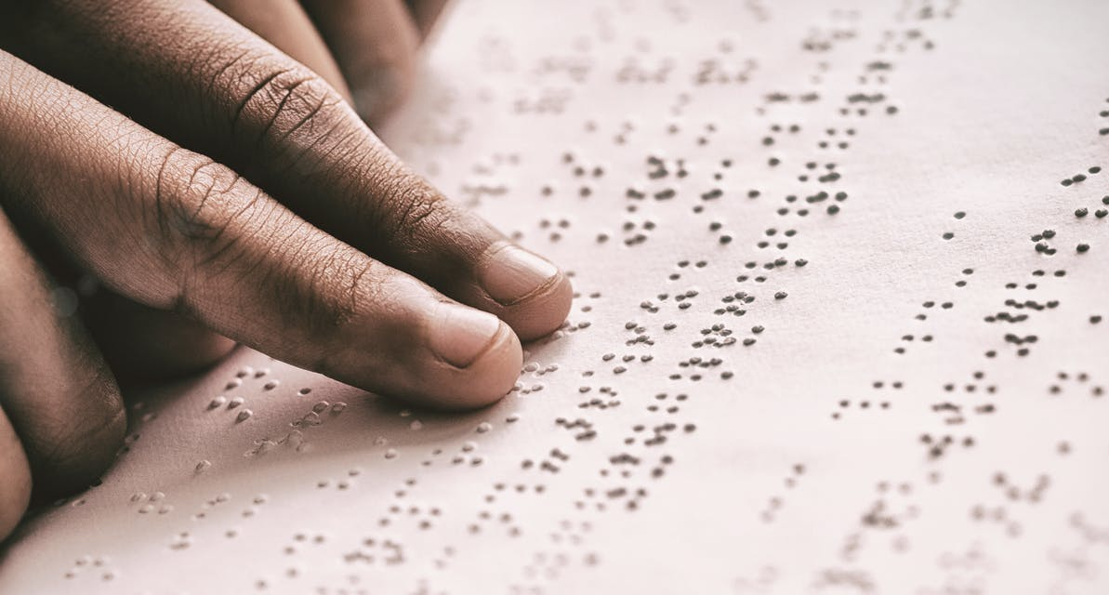
Inclusive Communication Recommendations
Consider digital literacy – old and young
Outside the digital mainstream
E.g. Young homeless, unemployed, seeking asylum
Consider disabilities and recognise they are a different ABILITY
Consider language
Consider mode
Consider Method

Slide 18
Impact of Science
23-25 June, 2021
Dariusz Aksamit
Head of Council of March for Science Foundation, Poland
#IOS21

Slide 19
Battlefield: social media!
Dariusz Aksamit
March for Science Foundation www.aksamit.info
AESIS Impact of Science 2021

Slide 20
What does „war” have to do with
„science communication”
?

Slide 22
We have opposing sides and innocent civilians get hurt

Slide 23
We have opposing sides and innocent civilians get hurt
Not vaccinated?

Slide 26
We have opposing sides and innocent civilians get hurt
And war is not only about a fight

Slide 27
We have opposing sides and innocent civilians get hurt
And war is not only about a fight
Training?
Logistics & technical suport?
Intelligence?

Slide 28
Without…
…Training?
…Logistics & technical suport?
…Intelligence?

Slide 29
Training? 04.03.2020, day 0

Slide 30
Training? 04.03.2020, day 0

Slide 31
Intelligence?
Yes – like infiltration

Slide 32
Yes, you can be harmed on a battlefield

Slide 33
https://bmjopen.bmj.com/content/bmjopen/10/7/e035626.full.pdf

Slide 34
https://bmjopen.bmj.com/content/10/7/e035626

Slide 35
https://bmjopen.bmj.com/content/10/7/e035626

Slide 36
… complaint to Professional Liability Ombudsman…

Slide 37
Fired from Postgraduate Medical Education Centre
… but designated by Suprem Medical Council as Chief Expert for COVID-19

Slide 39
https://bmjopen.bmj.com/content/10/7/e035626

Slide 40
Conclusion:
Be prepared!

Slide 41
Find your place in that info-war:
On the front line?
-> Take your media training before!
As a suport?
-> Establish network – with journalist, influencers, youtubers…
Operation in cover?
-> yes, you have to create a fake account:p but you spy for right side of this warfare

Slide 42
What would really help?

Slide 43
https://bmjopen.bmj.com/content/10/7/e035626

Slide 44
Spoiler:
Government is not always on your side!!!

Slide 45
https://www.facebook.com/pg/bartstaszewski/photos/?ref=page_internal

Slide 46
Fired from Postgraduate Medical Education Centre
… but designated by Suprem Medical Council as Chief Expert for COVID-19

Slide 47
„Science Communication in civil society”
…partisan?

Slide 48
Being INDEPENDENT
Being PROTECTED by network
Opportunities?
Being EFFICIENT
Being INFLUENTIAL

Slide 49
Battlefield: social media!
Dariusz Aksamit
March for Science Foundation www.aksamit.info
AESIS Impact of Science 2021

Slide 50
Impact of Science
23-25 June, 2021
Marina Joubert
Senior Researcher, Stellenbosch University, South Africa
#IOS21

Slide 51
When scientists become media stars
The case of South Africa’s Salim Abdool Karim during the
Covid-19 crisis in South Africa
Dr Marina Joubert, Stellenbosch University, South Africa
AESIS Conference 23 – 25 June 2021

Slide 53
Visible scientists
hot topic
controversial
articulate
colourful image, appearance and personality
they touch the right chords with the public
competitive and ambitious
they enjoy credibility within science
understand the needs of the mass media; take advantage of media opportunities and typically develop strong relationships and sophistication in their dealings with journalists

Slide 55
“stars that grip the public imagination”
“articulate, controversial, distinctive”
How they communicate
Topic tied to public issues
Interesting personalities
‘a compelling presence’ & ‘good looks’
2015

Slide 60
March for science, April 14, 2018 Durban, South Africa

Slide 65
#ProfKarim SA’s Covid-19 Hero!
This man gives SA peace in his explanations.
What a great resource to SA at this time!
#ProfKarim: World-class. Proudly South African!

Slide 80
Carlos Amato

Slide 90
marinajoubert@sun.ac.za
@marinajoubert

Slide 91
Impact of Science
23-25 June, 2021
Thank you
#IOS21

